Slide 1

Chapter 4
High-Level Database Model

Slide 2
OBJECTIVES
Understand concepts of:
Database Design Process
Data modeling basing on entity relationship
Design a suitable database adapted business requirements in reality

Slide 3
CONTENT
4.1. Database design process
4.2. Entity relationship model
4.3. What are entity, entity set, attribute, relationship?
4.4. Entity Relationship Diagram (ERD)
4.5. Attributes on Relationships
4.6. Weak Entities
4.7. Sub-class

Slide 4
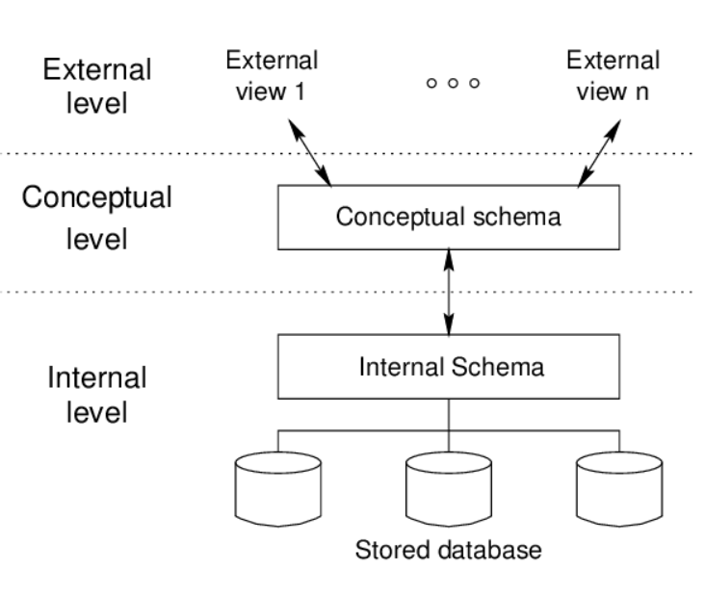
Data model - Overview

Slide 5
Database modeling and implementation process
Getting
User
Requirement
High-Level
Design
Relational
Database
Schema
Design
Relational DBMS
ER diagram
Relational Database Schema
Figure 4.1: The database modeling and implementation process
Notes:
Data Model - a group of conceptual tools that describes data, its relationships and semantics. It also consists of the consistency constraints that the data adheres to.

Slide 6
Steps in Database Design
Requirements Analysis
- user needs; what must database do?
Conceptual Design
- high level description (Entity Relationship diagram)
Logical Design
- translate ERD into DBMS data model
Schema Refinement
- consistency, normalization
Physical Design
- indexes, disk layout
Security Design
- who accesses what, and how

Slide 7
ERD – How to construct
Gather all the data that needs to be modeled.
Identify data that can be modeled as real world entities.
Identify the attributes for each entity.
Sort entity sets as weak or strong entity sets.
Sort entity attributes as key attributes, multi-valued attributes, composite attributes, derived attributes.
Identify the relations between the different entities.
Using the different symbols draw the entities, their attributes and their relationships. Use appropriate symbols while drawing attributes.

Slide 8
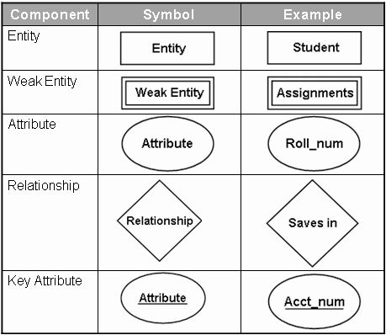
Entity Relationship Diagram - Notations

Slide 9
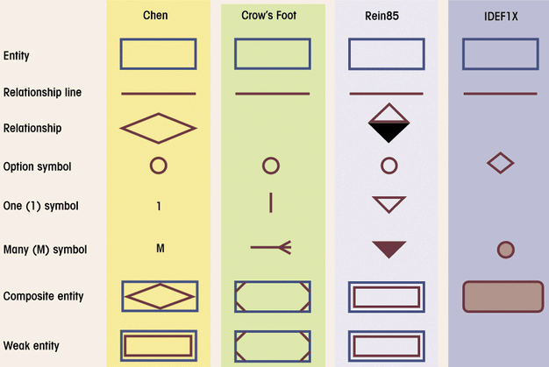
Comparison of E-R Modeling notations

Slide 10
ERD - Entity
Entity:
Real-world thing, distinguishable from other objects.
Noun phrase
Entity described by set of attributes.
Entity Set: A collection of similar entities. E.g., all employees.
All entities in an entity set have the same set of attributes. (Until we consider hierarchies, anyway!)
Each attribute has a domain.
name
ssn
lot
Employee

Slide 11
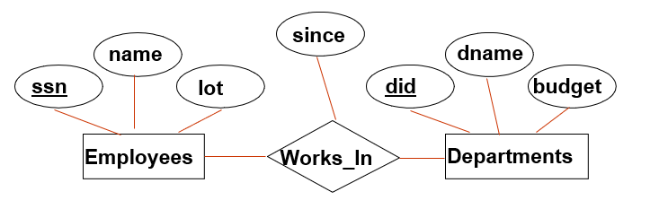
ERD - RELATIONSHIP
Relationship: Association among two or more entities. Relationships can have their own attributes (descriptive attributes).
verb phrases
1-1
1- M/ M -1
M - M
Degree Constraints
Recursive relationship
Unary, Binary, Ternary relationship (quan hệ 1 ngôi, hai ngôi,...)
A referential integrity constraints (ràng buộc toàn vẹn tham chiếu)
A value appearing in one context must also appear in another

Slide 12
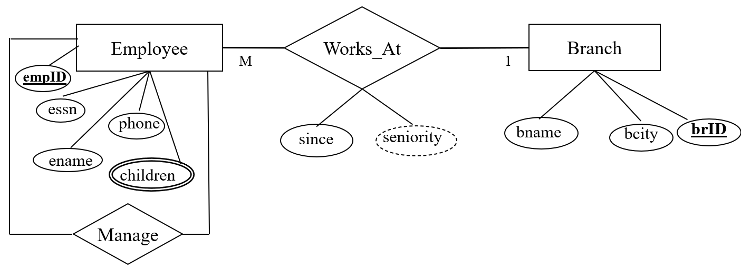
Type of Attributes
Key attribute (khoá)
Multivalued attribute (đa trị)
Derived attribute (suy ra)
Composite attribute (tổng hợp)
EmpID
children
seniority
Address
Address

Slide 13
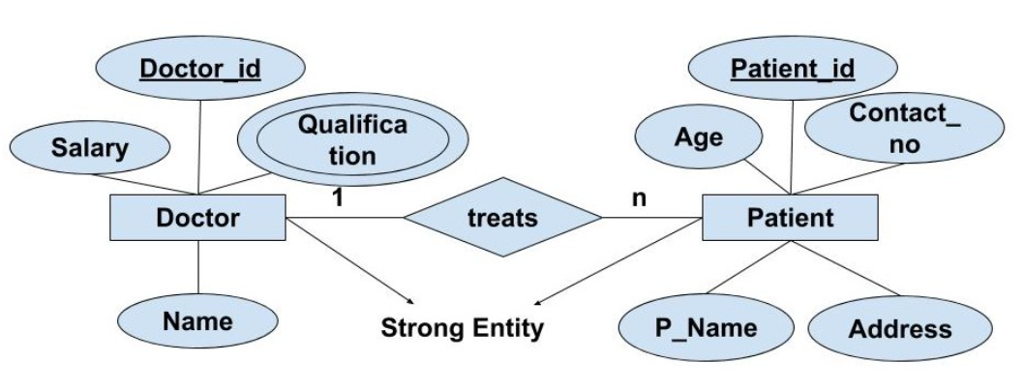
Strong Entity
A strong entity is an entity type whose existence doesn't depend on any other entity.
1

Slide 14
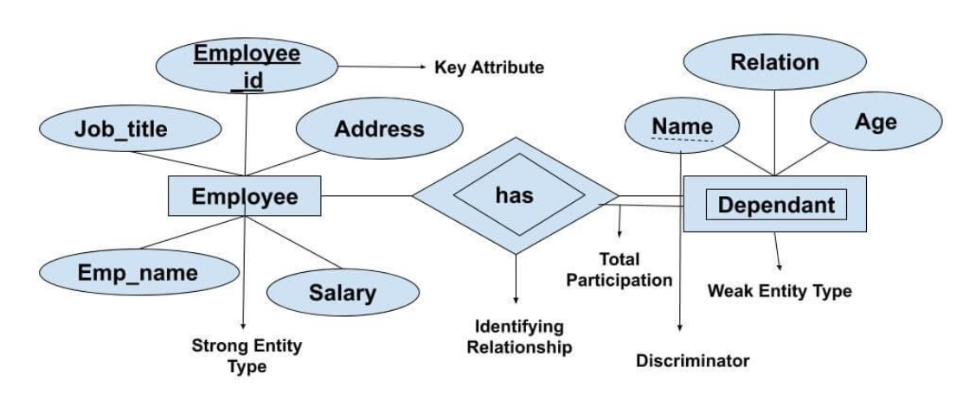
Weak Entity Sets
Weak entity type doesn’t have a key attribute. Weak entity type can’t be identified on its own. It depends upon some other strong entity for its distinct identity
1

Slide 15
Requirements for Weak Entity Sets
R is a relationship from E to F
R is called supporting relationship if
R must be a binary, many-one (M - 1) relationship from E to F
R must have referential integrity from E to F
The attributes that F supplies for the key of E must be key attributes of F

Slide 16
Subclasses in E/R Model
Consider Cartoons and Murder Mysteries are the special kinds of movies, with some special properties
to Stars
length
title
year
genre
Movies
Voices
isa
isa
weapon
Cartoons
Murder Mysteries

Slide 17
Example COMPANY Database – Construct ERD
Requirements:
The company is organized into DEPARTMENTs. Each department has a name, number and an employee who manages the department. We keep track of the start date of the department manager.
Each department controls a number of PROJECTs. Each project has a name, number and is located at a single location.

Slide 18
Example COMPANY Database (Cont.)
We store each EMPLOYEE’s social security number, address, salary, sex, and birthdate. Each employee works for one department but may work on several projects. We keep track of the number of hours per week that an employee currently works on each project. We also keep track of the direct supervisor of each employee.
Each employee may have a number of DEPENDENTs. For each dependent, we keep track of their name, sex, birthdate, and relationship to employee.

Slide 19
ERD
Design ERD by yourself

Slide 20
EX1
Create an Entity-Relationship Diagram (ERD) as a basis for designing the data structure to manage the university.
The Ministry of Education and Training conducts surveys of universities. Each university has multiple faculties, and each faculty comprises several departments, with each department having numerous instructors.
To enhance the quality of education, universities stipulate that each instructor can only teach one subject, and each subject is managed by one instructor. Within the universities, each faculty oversees multiple classes, and each class consists of many students. Throughout their years at the university, each student must take multiple subjects, and each subject can have many participating students.

Slide 21
From ER Diagram to Relational Model
Overview:
1 entity = 1 relation
attributes of entity ~ attributes of relation
key of entity ~ key of relation
Convert 1-1 relationship
Convert 1- M relationship
Put key attribute of one-side to n-side
Convert M-M relationship
Generate 1 relation, Primary key of this relation combined from two relations. Attributes of new relation ~ attributes of relationship (if have)

Slide 22
From ER Diagram to Relational Model Convert 1-1 relationship
For one-to-one relationship without total participation
Build a table with two columns, one column for each participating entity set’s primary key. Add successive columns, one for each descriptive attributes of the relationship set (if any).
For one-to-one relationship with one entity set having total participation
Augment one extra column on the right side of the table of the entity set with total participation, put in there the primary key of the entity set without complete participation as per to the relationship.

Slide 23
Convert N-ary Relationship Set
P-Key1
D-Attribute
A-Key
E-Set 1
P-Key2
A relationship
Another Set
E-Set 2
P-Key3
E-Set 3
P-Key1 | P-Key2 | P-Key3 | A-Key | D-Attribute
9999 | 8888 | 7777 | 6666 | Yes
1234 | 5678 | 9012 | 3456 | No
* Primary key of this table is P-Key1 + P-Key2 + P-Key3

Slide 24
Representing Composite Attribute
Relational Model Indivisibility Rule Applies
One column for each component attribute
NO column for the composite attribute itself
SSN
Name
SSN | Name | Street | City
9999 | Dr. Smith | 50 1st St. | Fake City
8888 | Dr. Lee | 1 B St. | San Jose
Professor
Address
Street
City

Slide 25
Representing Multivalue Attribute
For each multivalue attribute in an entity set/relationship set
Build a new relation schema with two columns
One column for the primary keys of the entity set/relationship set that has the multivalue attribute
Another column for the multivalue attributes. Each cell of this column holds only one value. So each value is represented as an unique tuple
Primary key for this schema is the union of all attributes

Slide 26
Example – Multivalue attribute
The primary key for this table is Student_SID + Children, the union of all attributes
SID
Name
Children
Student
Major
GPA
Stud_SID | Children
1234 | Johnson
1234 | Mary
5678 | Bart
5678 | Lisa
5678 | Maggie
SID | Name | Major | GPA
1234 | John | CS | 2.8
5678 | Homer | EE | 3.6

Slide 27
Representing Class Hierarchy
Two general approaches depending on disjointness and completeness
For non-disjoint and/or non-complete class hierarchy:
create a table for each super class entity set according to normal entity set translation method.
Create a table for each subclass entity set with a column for each of the attributes of that entity set plus one for each attributes of the primary key of the super class entity set
This primary key from super class entity set is also used as the primary key for this new table

Slide 28
Example
SSN
Name
Person
SID
Status
Gender
ISA
Student
Major
GPA
SSN | Name | Gender
1234 | Homer | Male
5678 | Marge | Female
SSN | SID | Status | Major | GPA
1234 | 9999 | Full | CS | 2.8
5678 | 8888 | Part | EE | 3.6

Slide 29
Representing Class Hierarchy
Two general approaches depending on disjointness and completeness
For disjoint AND complete mapping class hierarchy:
DO NOT create a table for the super class entity set
Create a table for each subclass entity set include all attributes of that subclass entity set and attributes of the superclass entity set
Simple and Intuitive enough, need example?

Slide 30
Example
SSN
Name
No table created for superclass entity set
People
ISA
SID
Faculty
Student
Disjoint and Complete mapping
Major
GPA
Dept
SSN | Name | SID | Major | GPA
1234 | John | 9999 | CS | 2.8
5678 | Mary | 8888 | EE | 3.6
SSN | Name | Dept
1234 | Homer | C.S.
5678 | Marge | Math

Slide 31
Representing Aggregation
Name
SSN
Name
n
1
Student
Advisor
Professor
Dept
SID
Name
member
Primary Key of Advisor
Dept
SID | Code
1234 | 04
5678 | 08
Code
Primary key of Dept

Slide 32
From E/R Relationship to Relations
Stars
Contracts
Movies
Studio
of star
Producing
studio
Studios
Contracts(starName, title,year, studioOfStar_name, producingStudio_name)

Slide 33
Combining Relations
name
address
Movies(title,year,length,genre)
Owns(title,year,studioName)
Stars
title
year
Stars-in
name
Movies
Studios
Owns
length
genre
address
Movies(title,year,length,genre,studioName)
Suppose an entity set E and a many-one relationship R from E to F. We can combine two relations E and R into one relation with a schema consisting of:
All attributes of E,
The key attributes of F, and all own attributes belonging to relationship R

Slide 34
Handling Weak Entity Sets
number
crewChief
name
address
Crews
Unit-of
Studios
Studios(name,address)
Crews(number,crewChief,studioName)
If W is a weak entity set, construct for W a relation whose schema consists of:
All attributes of W
All own attributes of supporting relationships for W
For each supporting relationship for W, say a many-one relationship from W to entity set E, all the key attributes of E
Rename attributes, if necessary, to avoid name conflicts
Do not construct a relation for any supporting relationship for W

Slide 35
Converting Subclass Structures to Relations
How we convert this structure to relations?
to Stars
length
title
year
genre
Movies
Voices
isa
isa
weapon
Cartoons
Murder Mysteries

Slide 36
Converting Subclass Structures to Relations
The principal conversion strategies
Follow E/R viewpoint
For each entity set E in the hierarchy, create a relation that includes the key attributes from the root and any attributes belong to E
Treat entities as object-oriented
For each possible subtree that includes the root, create one relation, whose schema includes all the attributes of all the entity sets in the subtree
Use null values
Create only one relation with all attributes of all entity sets in the hierarchy. Each entity is represented by one tuple, and that tuple has a NULL value for whatever attributes the entity does not have

Slide 37
E/R Style Conversion
to Stars
length
title
year
genre
Movies
Voices
isa
isa
weapon
Cartoons
Murder Mysteries
Movies(title,year,length,genre)
MurderMysteries(title,year,weapon)
Cartoons(title,year) ← remove
Voices(title,year,starName)

Slide 38
An Object-Oriented Approach
to Stars
length
title
year
genre
Movies
Voices
isa
isa
weapon
Cartoons
Murder Mysteries
Movies(title,year,length,genre)
MoviesC(title,year,length,genre)
MoviesMM(title,year,length,genre,weapon)
MoviesCMM(title,year,length,genre,weapon)

Slide 39
Using Null Values
to Stars
length
title
year
genre
Movies
Voices
isa
isa
weapon
Cartoons
Murder Mysteries
Movie(title,year,length,genre,weapon)

Slide 40
Unified Modeling Language –self studying
Introduction
UML is designed to model software in an object-oriented style, but has been adapted as a database modeling language
UML offers much the same capabilities as the E/R model, with the exception of multi-way relationships, only binary relationships in UML.

Slide 41
UML vs. E/R Model
UML | E/R Model
Class | Entity Set
Association | Binary relationship
Association class | Attributes on a relationship
Subclass | is-a hierarchy
Aggregation | Many-one relationship
Composition | Many-one relationship with referential integrity
Figure 4.34: Comparison between UML and E/R terminology

Slide 42
UML Classes
Movies
title PK year PK length genre init() modify()
State
Class’ name
Behavior

Slide 43
Associations
Consider an associations between Movies, Stars, and Studios in UML
Studios
name PK
address
0..1
Owns
Movies
title PK
year PK
length
genre
0..*
Stars
name PK
address
0..*
0..*
Stars-in

Slide 44
Associations
Comparison with E/R Multiplicities
E/R UML
0..* 0..*
0..* 0..1
0..* 1..1

Slide 45
Self-Associations
An association can have both ends at the same class; such an association is called a self-association
Example
Movies
title PK
year PK
length
genre
0..1
theOriginal
0..*
theSequel

Slide 46
Association Classes
Movies
title PK
year PK
length
genre
Stars
name PK
address
0..*
Stars-in
0..*
Compensation
salary
residuals

Slide 47
Subclasses in UML
Consider Movies and its three subclasses
Figure 4.40: Cartoons and murder mysteries as disjoint subclasses of movies
Movies
title PK
year PK
length
genre
Murder Mysteries
weapon
Cartoons
Cartoon-Murder Mysteries
weapon

Slide 48
Aggregations and Compositions
MovieExecs
cert# PK
name
address
networth
Movies
title PK
year PK
length
genre
Studios
name PK
address
Presidents
1..*
0..1
0..1
1..1
Figure 4.41: An aggregation from Movies to Studios and
a composition from Presidents to Studios

Slide 49
UML-to-Relations Basics
Classes to Relations
For each class, create a relation
name is the name of the class
attributes are the attributes of the class
Associations to Relations
For each association, create a relation
name is the name of that association
attributes are the key attributes of the two connected classes

Slide 50
UML-to-Relations Basics
Studios
name PK
address
0..1
Owns
Movies
title PK
year PK
length
genre
0..*
Stars
name PK
address
0..*
0..*
Stars-in
Movies(title,year,length,genre)
Stars(name,address)
Studios(name,address)
Stars-In(movieTitle,movieYear,starName)
Owns(movieTitle,movieYear,studioName)

Slide 51
From UML Subclasses to Relations
We can use any of the three strategies outlined for E/R to convert a class and its subclasses to relations
E/R-style: each subclass’ relation stores only its own attributes, plus key
OO-style: relations store attributes of subclass and all super-classes
Nulls: One relation, with NULL’s as needed

Slide 52
From Aggregations and Composition to Relation
No relation for the aggregation or composition
Add to the relation for the class at the non-diamond end the key attribute(s) of the class at the diamond end
In the case of an aggregation, it is possible that these attributes can be null

Slide 53
From Aggregations and Composition to Relation
MovieExecs
cert# PK
name
address
networth
MovieExecs(cert#,name,address,netWorth)
Presidents(cert#,studioName)
Movies(title,year,length,genre,studioName)
Studios(name,address)
Movies
title PK
year PK
length
genre
Studios
name PK
address
President
1..*
0..1
0..1
1..1

Slide 54
The UML Analog of Weak Entity Sets
We use the composition, which goes from the weak class to the supporting class, for a weak entity set
Example:
Studios(name,address)
Crews(number,crewChief,studioName)
Crews
number PK
crewChief
Studios
name PK
address
0..*
1..1
PK

Slide 55
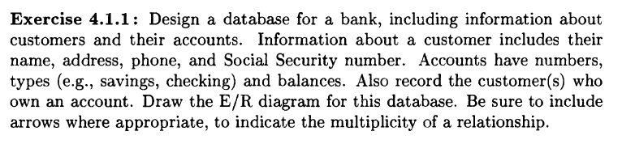
EXERCISE 1

Slide 56
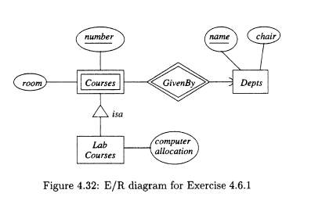
EXERCISE 2 - Convert ERD to RD

Slide 57
Steps to Convert ERD to Relational Schema
1. Identify Entities
- Convert each strong entity into a table.
- Attributes of the entity become columns in the table.
- Choose the primary key (PK) from the entity's key attributes.
2. Handle Weak Entities
- Create a table for each weak entity.
- Include attributes of the weak entity and add a foreign key (FK) referencing the strong entity it depends on.
- The combination of the FK and the weak entity's discriminator (if any) becomes the PK.

Slide 58
3. Map Relationships
1:1 Relationship: Add FK to one of the participating entity tables (preferably on the side with total participation).
1:N Relationship: Add FK to the "many" side referencing the "one" side.
M:N Relationship: Create a new table. Include FKs referencing the primary keys of the participating entities and any attributes of the relationship. Combine the FKs to form the PK.
4. Handle Multivalued Attributes
Create a new table.
Include the multivalued attribute and the PK of the entity it belongs to as FKs.
Combine the PK of the entity and the multivalued attribute to form the PK of the new table.

